Slide 1
LECTURE 05: DESIGN PRINCIPLES
October 6, 2016
SDS 136
Communicating with Data
Portions of this slide deck adapted from the “Visualization Principles” Tutorial by J. Kennedy, C. Nielson, & M. Krzywinski VIZBI 2012

Slide 2
So far…
Defining visualization
Exploring basic chart types (bar, line, scatter)
Fundamental principles:
visual perception
color theory

Slide 3
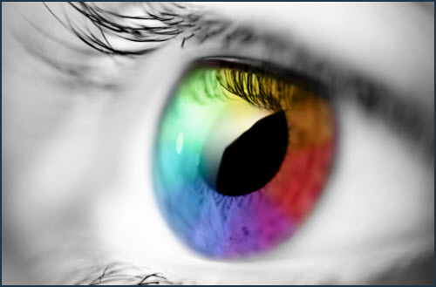
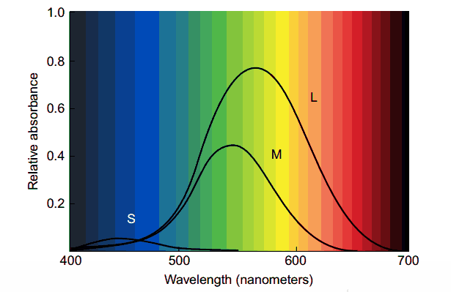

Recap: last class

Slide 4
Today
Color, part 2
Design principles
Mini-lab: “What’s Wrong with this Picture?”
Discussion

Slide 5

Color

Slide 6
Color spaces
A color space is mathematical model for describing color
RGB, HSB, HSL, Lab and LCH
RGB (red, green, blue) is the most commonly used
Why do you think that is?
Not very useful for visualizing information (why?)

Slide 7
Good vs. bad use of color
“Color used poorly is worse than no color at all”
Edward Tufte
“Above all, do no harm”
Color can cause the wrong information to stand out
Can also make meaningful information difficult to see

Slide 8
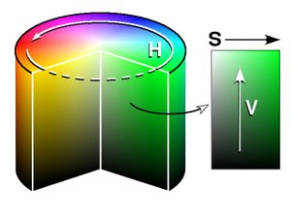
Another approach: HSV color space
Hue (color)
around the circle
Saturation
Inside to outside
Color to grey scale
Lightness (value)
top to bottom
more useful for visualization (why?)

Slide 9
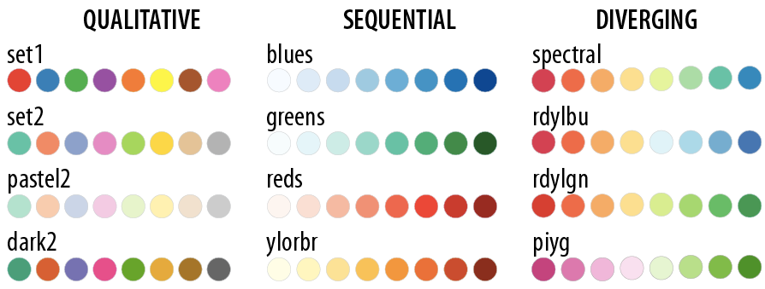
Colorbrewer palettes
colorbrewer.org provides a whole bunch of palettes based on the HSV color model
This makes life a lot easier for us!

Slide 10
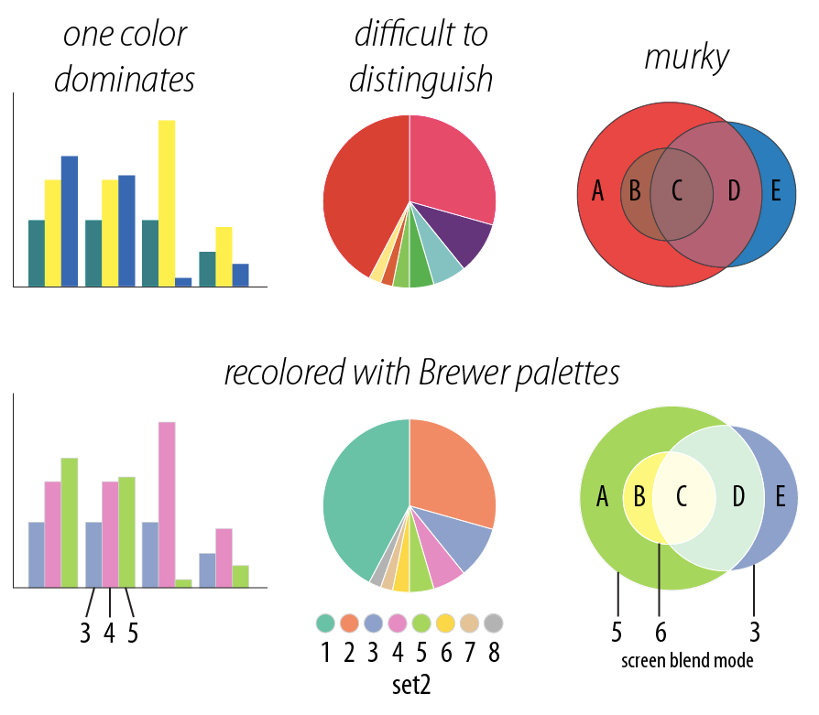
Example
One color dominates
Recolored with brewer palette

Slide 11
Example
Difficult to distinguish
Recolored with brewer palette

Slide 12
Example
Murky
Recolored with brewer palette

Slide 13
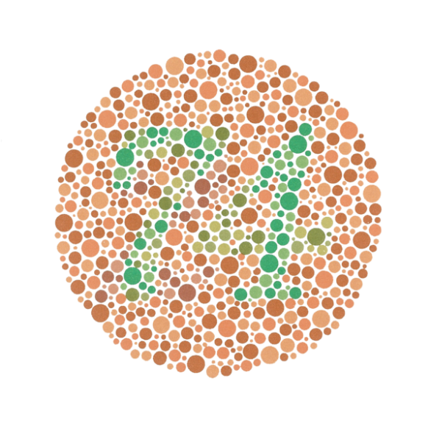
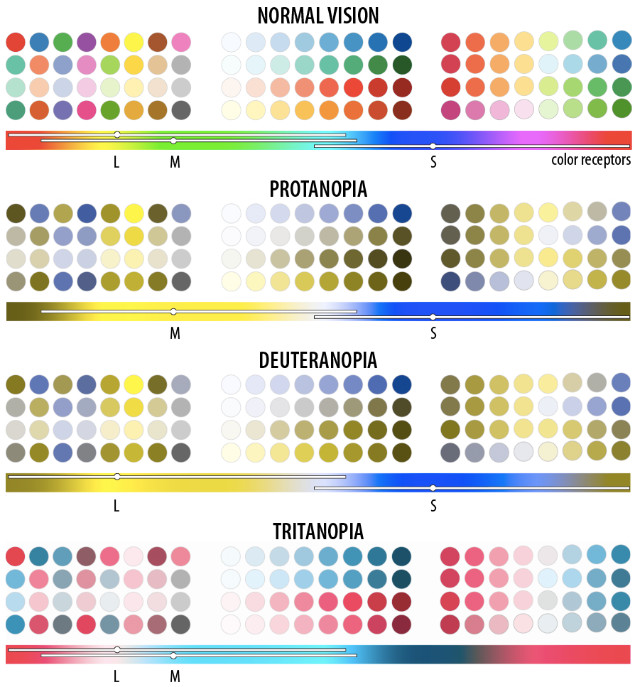
Fun fact: “colorblindness”
1 out of every 8 people has just 2 types of color receptors (rather than 3)

Slide 14
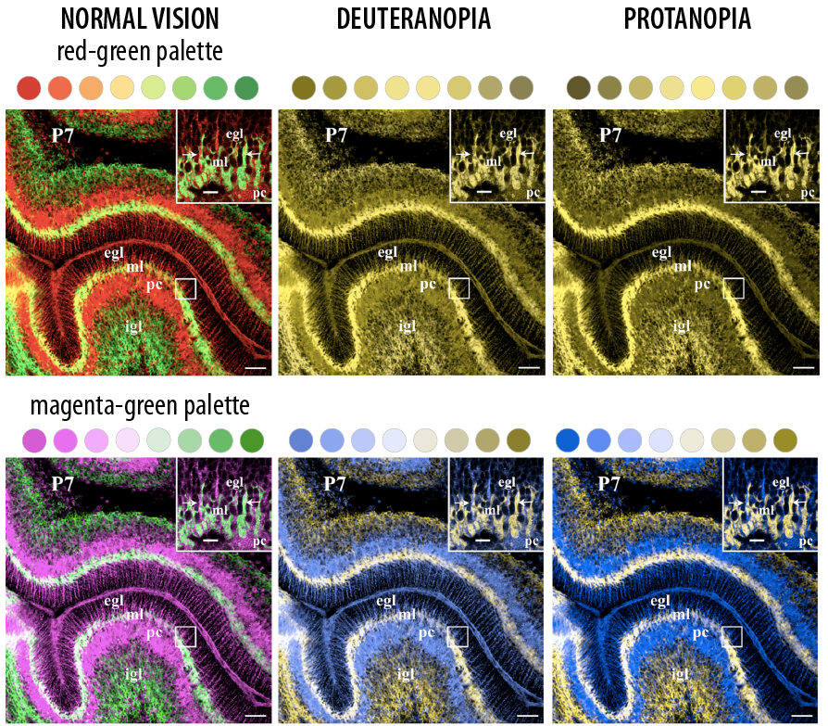
Brewer palettes can help here too!
Fig. Courtesy of M Krzywinski

Slide 15
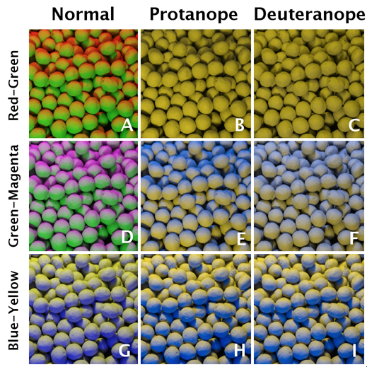
Can we do even better?
Gabriel Landini & D Giles Perryer, Image recolouring for colour blind observers

Slide 16
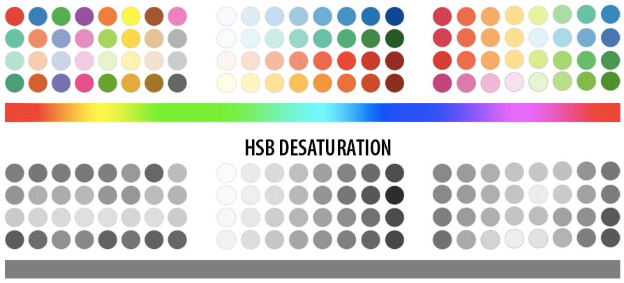
What happens when you print?
Need color scheme that converts well to grey scale

Slide 17
Design challenge
We know that the wrong visual encoding can mislead or confuse the reader
Problem: there are many possible encodings, and we want to pick the best one for our data and purpose

Slide 18

Discussion
What makes a good encoding?

Slide 19
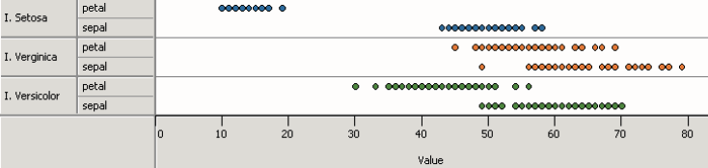
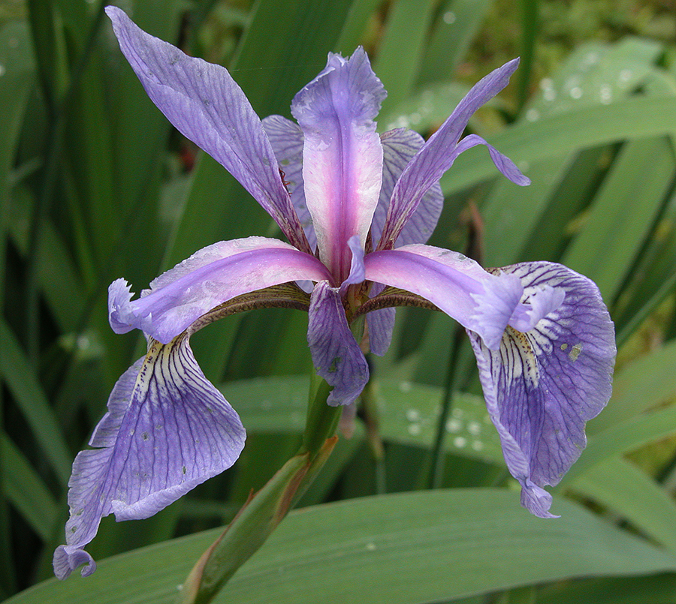
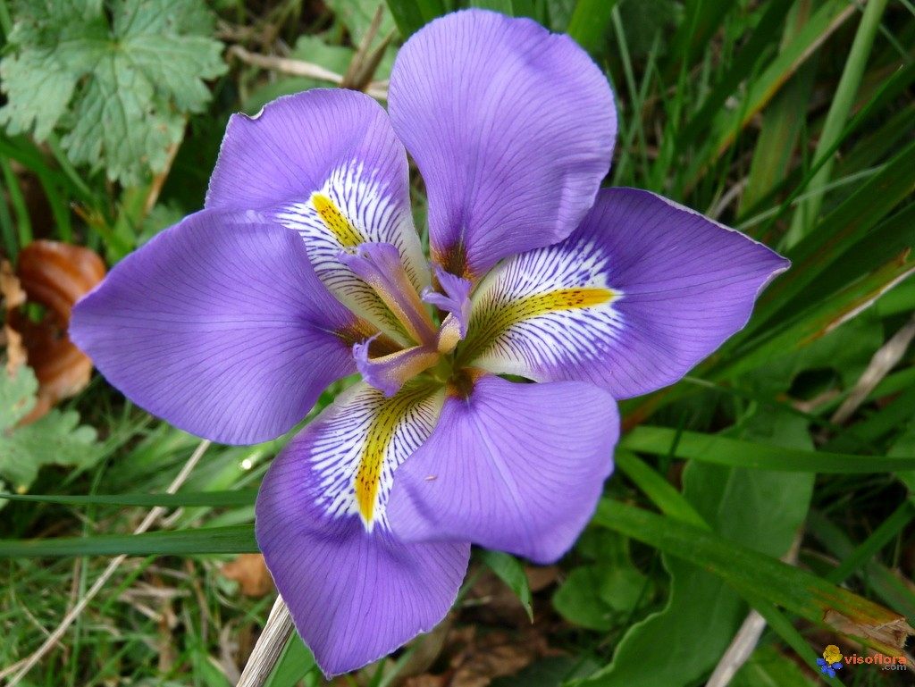
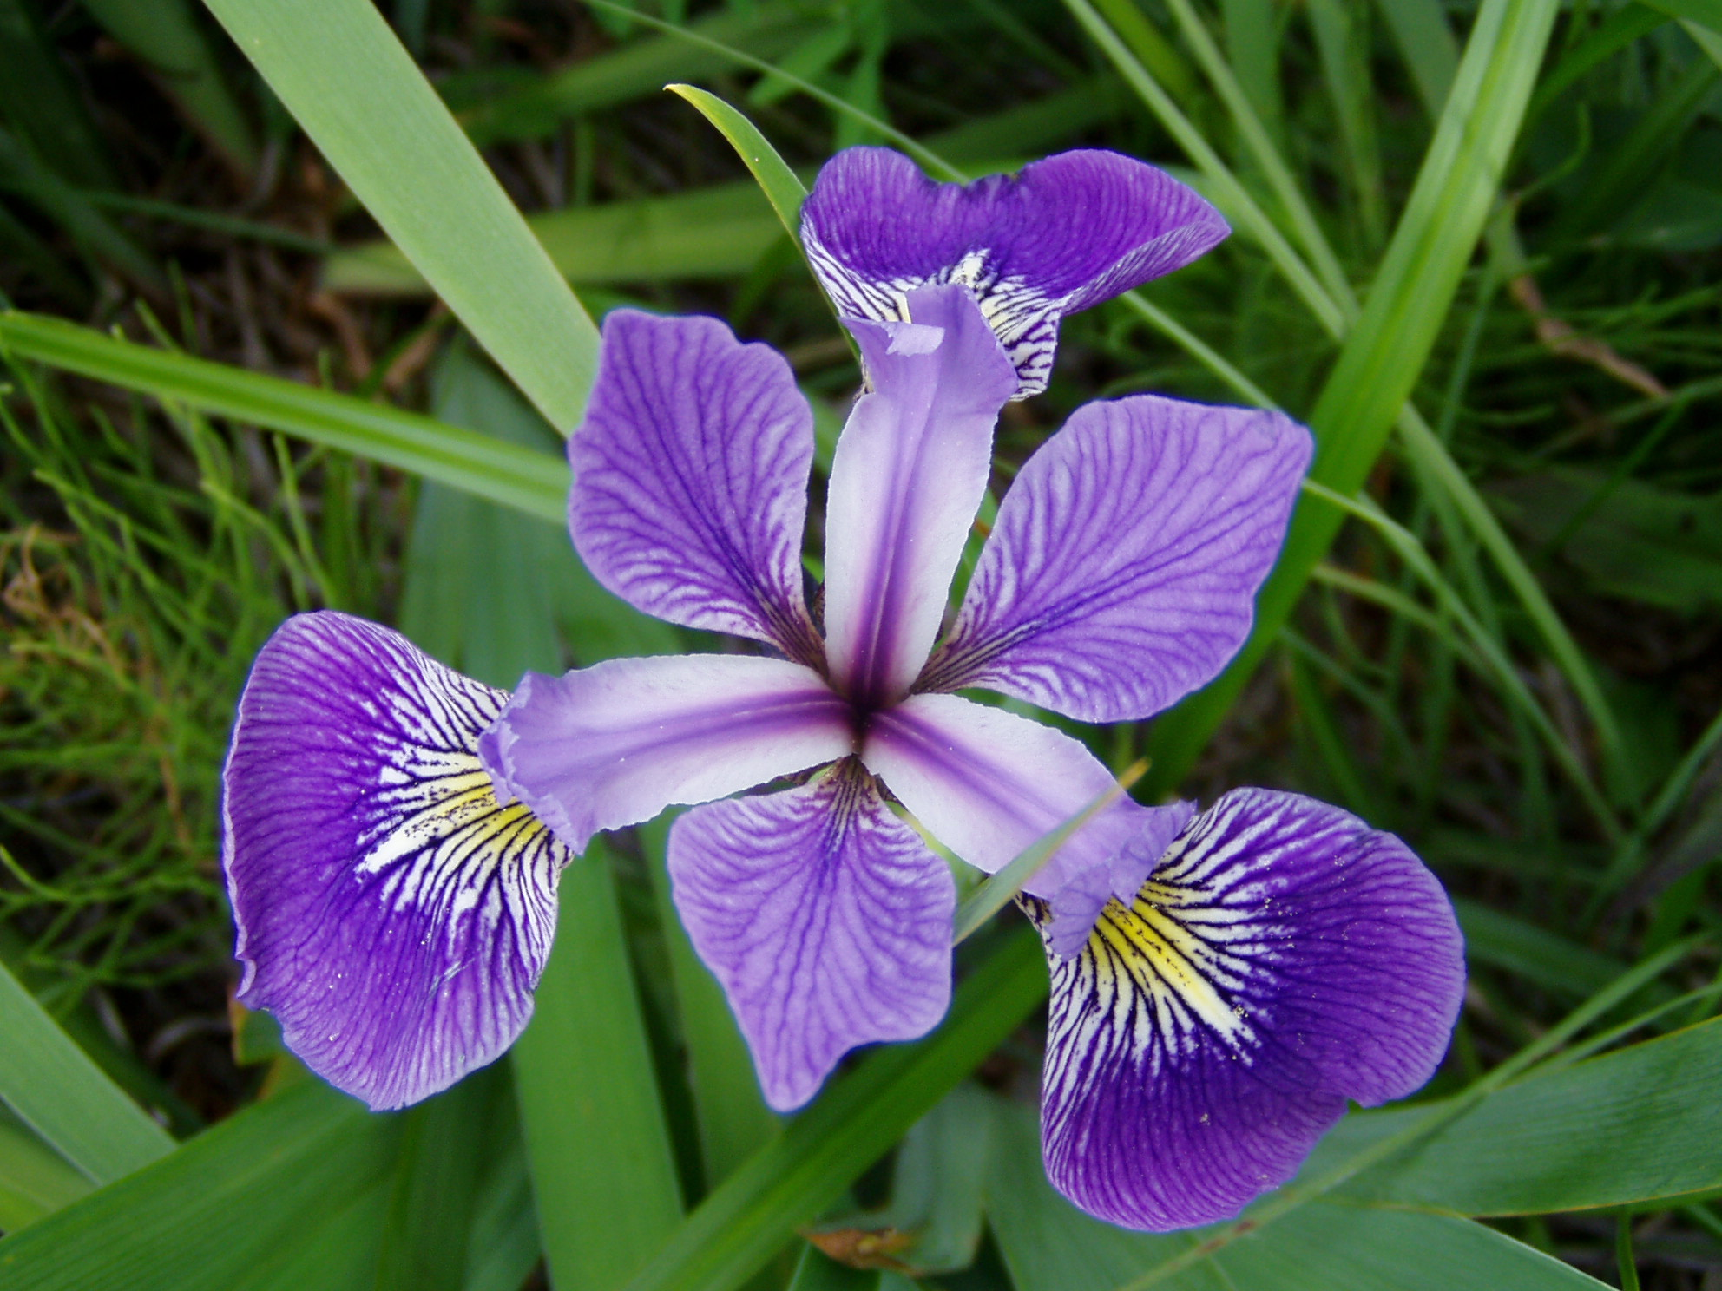
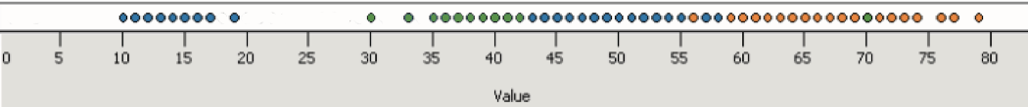
Principle 1: expressiveness
Encodes all the facts
Example:
Fig. Courtesy of M Krzywinski

Slide 20
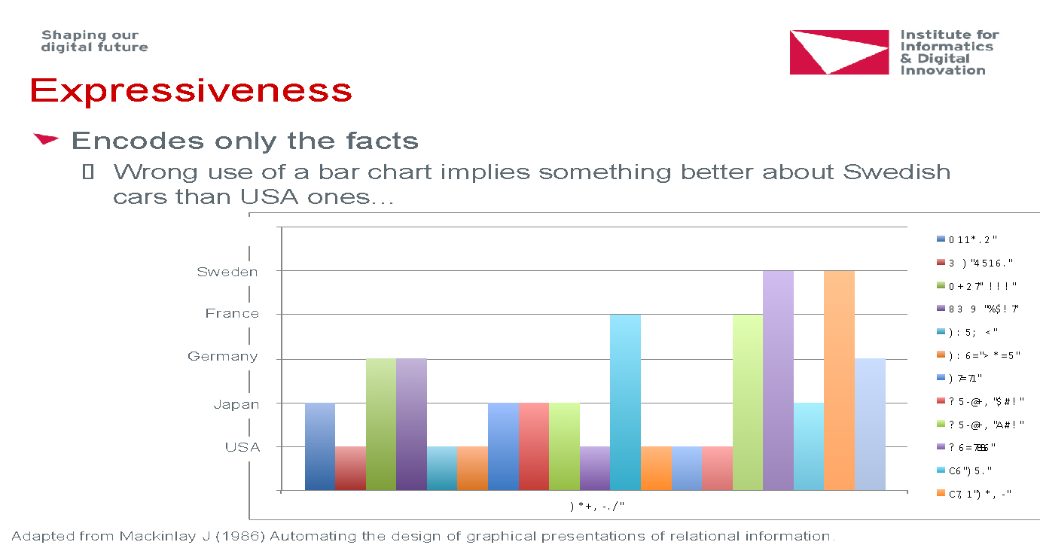
Principle 1: expressiveness
Encodes only the facts
Example:
Adapted from Mackinlay J (1986) Automating the design of graphical presentations of relational information.

Slide 21
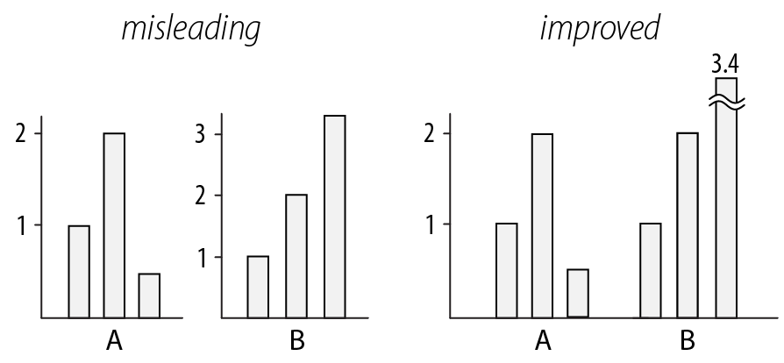
Principle 2: consistency
Use consistent axes when comparing charts
Raina SZ, et al. (2005) Evolution of base-substitution gradients
in primate mitochondrial genomes. Genome Res 15: 665-673.
M. Krzwinski, behind every great visualization is a design
principle, 2012

Slide 22
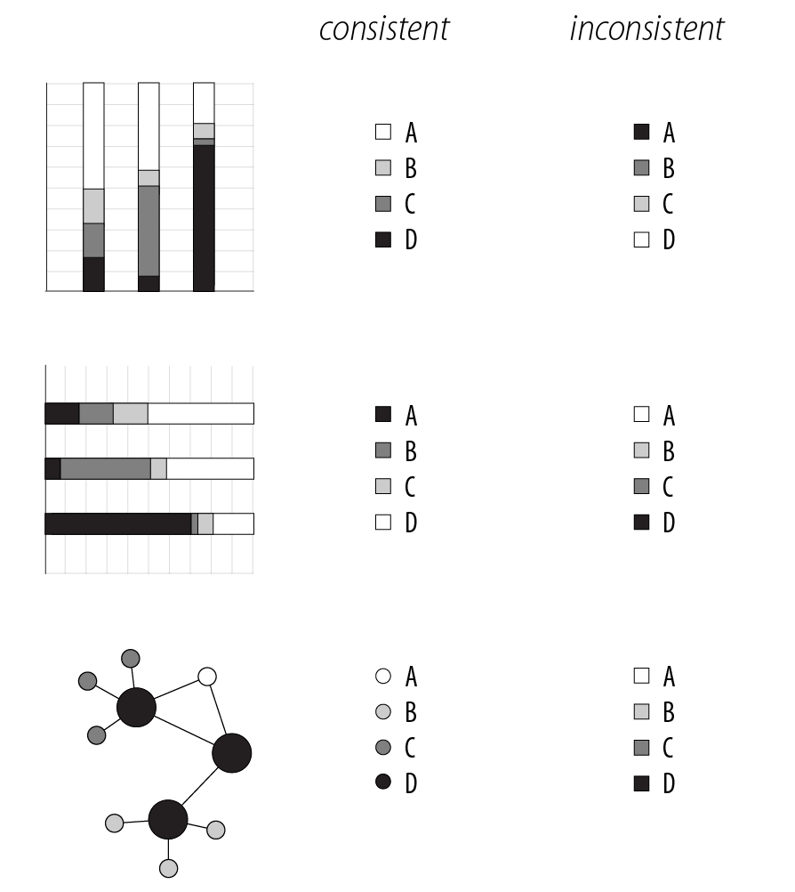
Principle 2: consistency
A note on legends: order items according to appearance
M. Krzwinski, behind every great visualization is a design principle, 2012

Slide 23
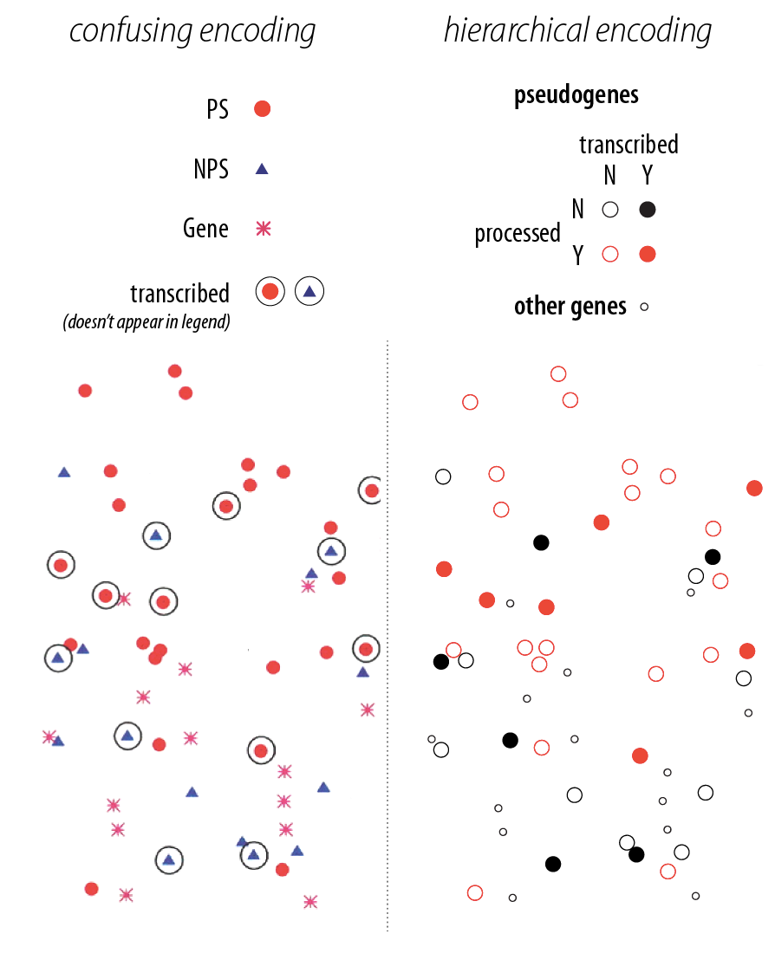
Principle 2: consistency
Visual variation should reflect and enhance the underlying variation in the data
Avoid visually similar encodings for independent variables
Example:

Slide 24
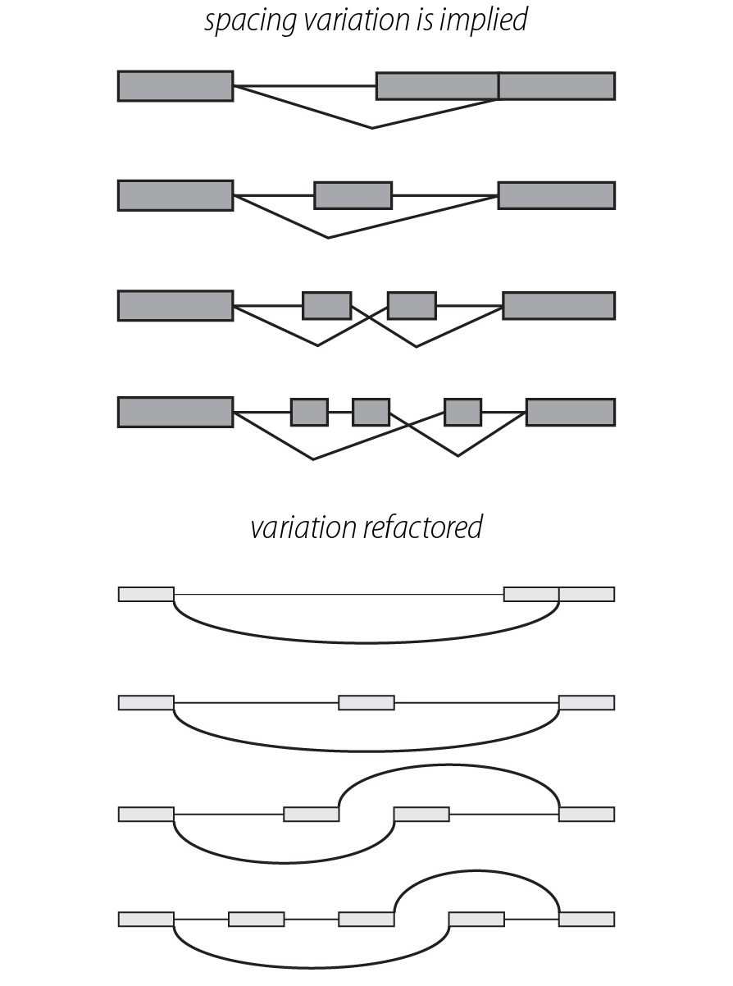
Principle 2: consistency
Uniform size and alignment reduces visual complexity and aids interpretation
Example:
Fig. 1: Sharov AA et al. (2005) Genome-wide assembly and analysis of alternative transcripts in mouse. Genome Res 15: 748-754.
Fig. 2: M. Krzwinski, behind every great visualization is a design principle, 2012

Slide 25
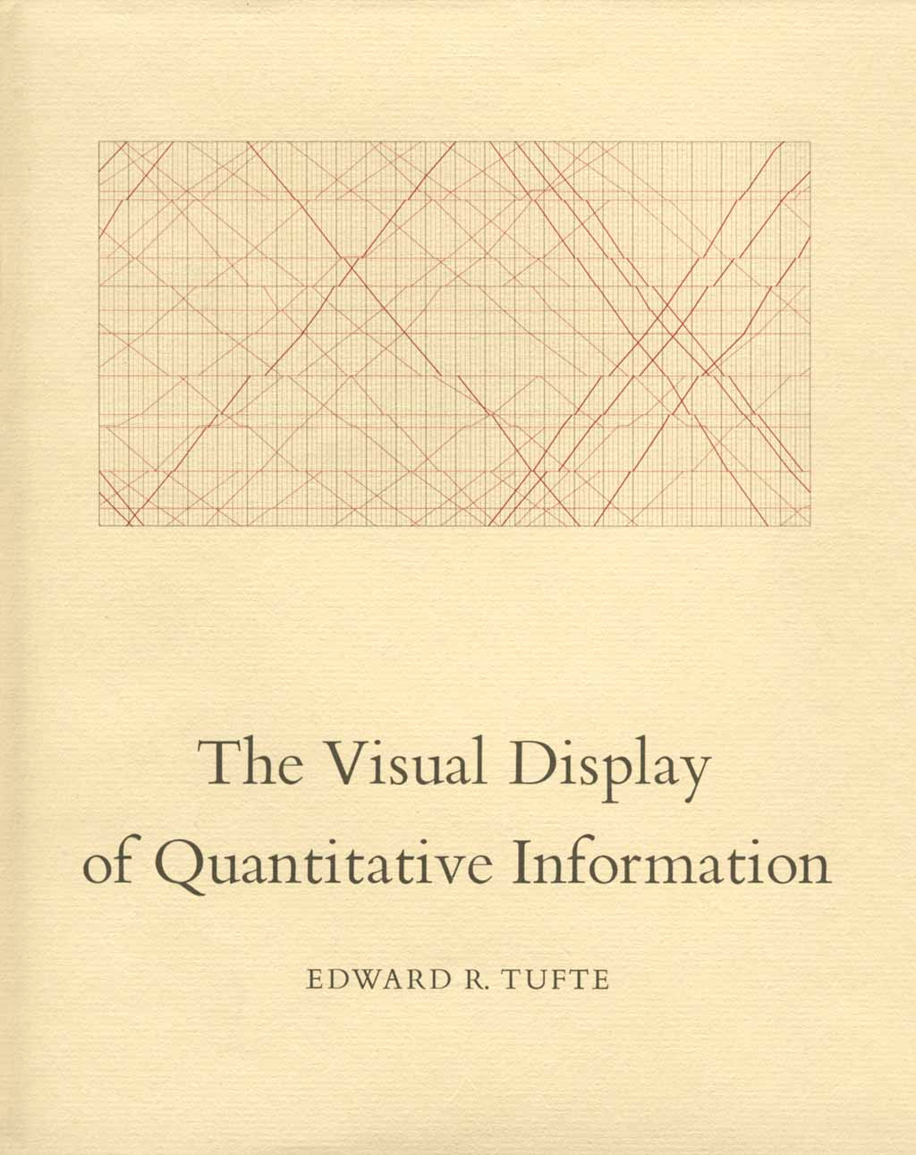
Tufte, 1983
“Above all else, show the data.”

Slide 26

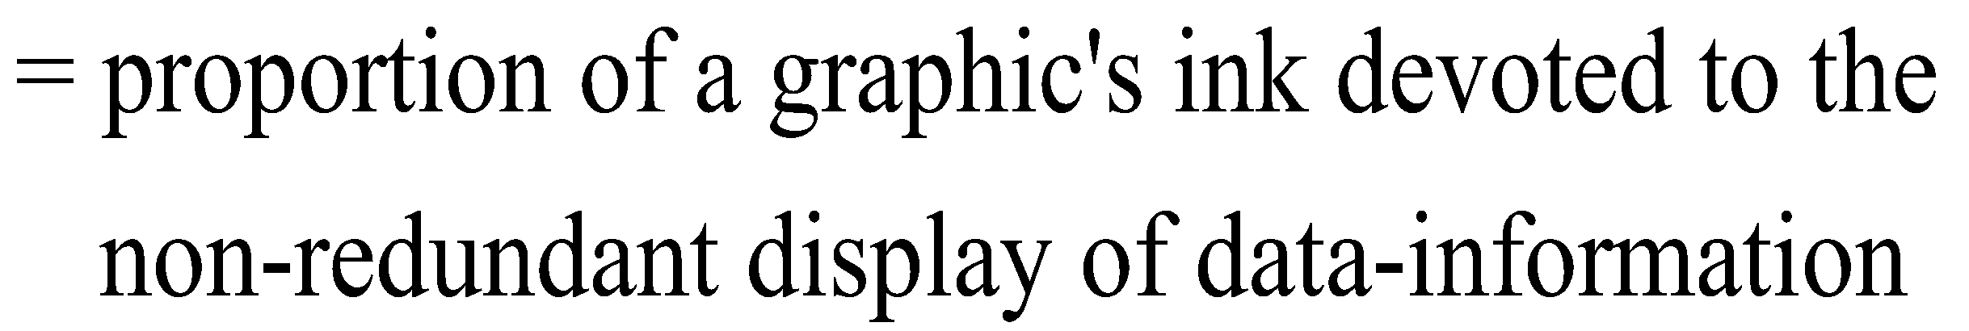
Tufte, 1983

Slide 27
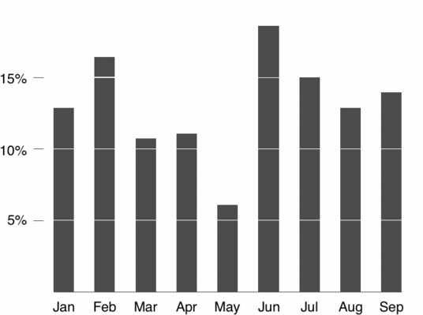
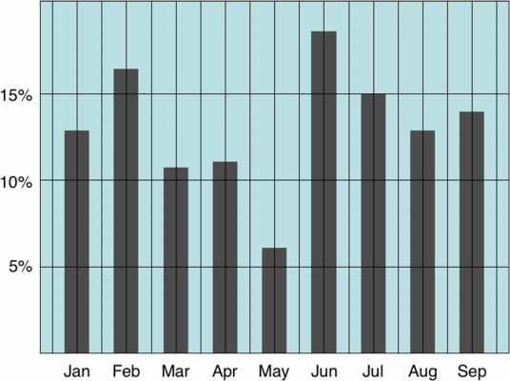
Tufte: maximize the data-ink ratio

Slide 28
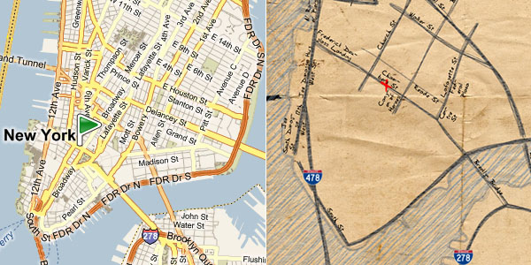
Familiar example

Slide 29
Discussion
What do you think of the data-ink ratio?
Consider ways to maximize it…

Slide 30
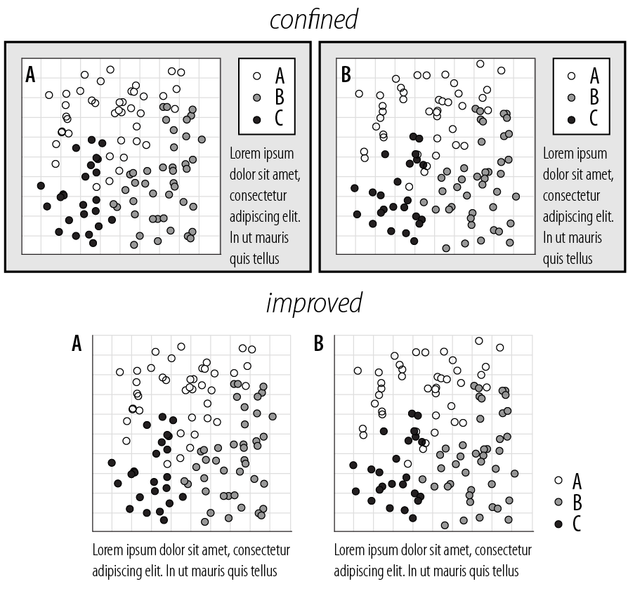
Principle 3: importance ordering
Avoid unnecessary containment and repetition
Example

Slide 31
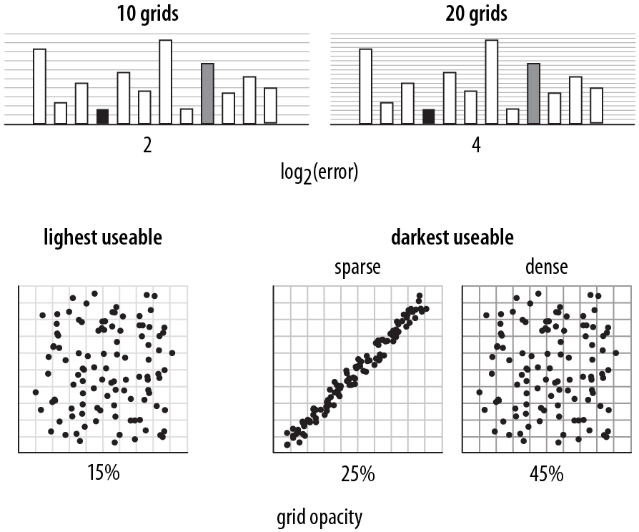
Principle 3: importance ordering
Navigational aids shouldn’t compete with data
Avoid: heavy axes, error bars and glyphs
Heer J, Bostock M (2010) Crowdsourcing graphical perception: using mechanical turk to assess visualization design.
Proceedings of the 28th international conference on Human factors in computing systems. Atlanta, Georgia, USA: ACM. pp. 203-212.

Slide 32
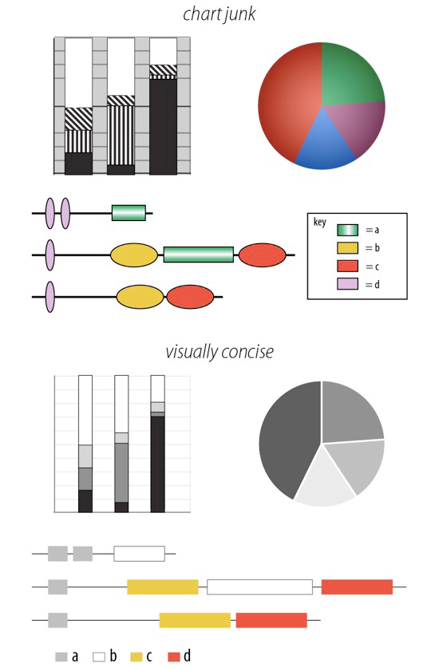
Principle 3: importance ordering
Simplify, simplify, simplify…
Sharov AA, et al (2006) Genome Res 16: 505-509.
Peterson J, et al. (2009) Genome Res 19: 2317-2323.
Thomson NR, et al. (2005) Genome Res 15: 629-640.
DB, Ko MS (2005) Genome Res 15: 748-754.
M. Krzwinski, behind every great visualization is a design
principle, 2012

Slide 33
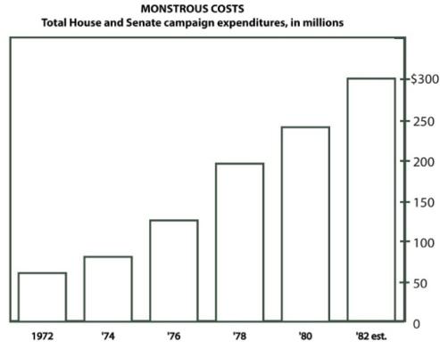
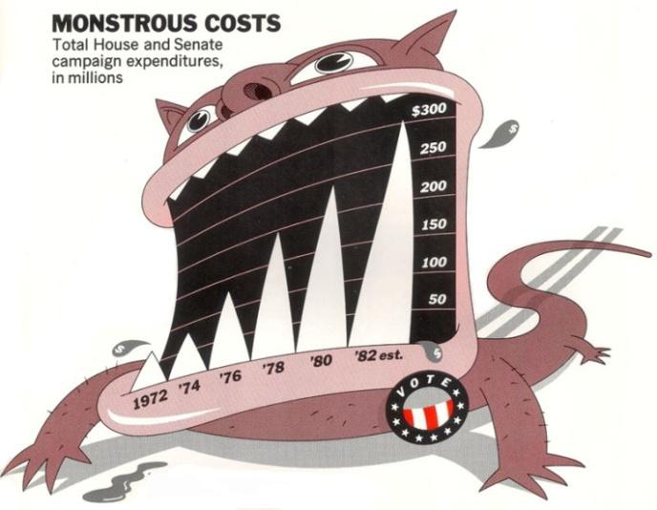
A caveat: “chart junk” and recall
Bateman et al. “Useful Junk? The Effects of Visual Embellishment on Comprehension and Memorability of Charts”, CHI 2010

Slide 34
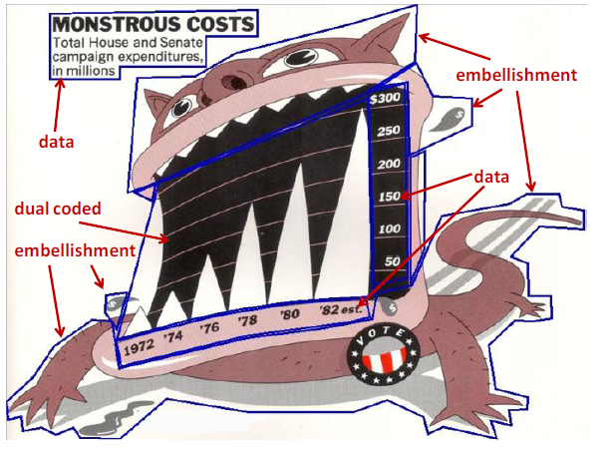
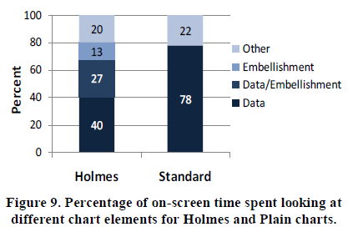
Chart junk and eye gaze

Slide 35
Mini-lab: “What’s wrong with this picture?”
Break into groups of 2-3 people, and go to:
www.science.smith.edu/~jcrouser/SDS136/labs/design
During this lab, you will get to critique some professionally-made visualizations using these principles
Try to think about the following questions:
What is the first thing you notice about this visualization?
What point is this visualization trying to make?
Who is the intended audience?
What is the visualization doing well?
What problems do you see with the visualization design?
Why do you think the designer made those choices?

Slide 36
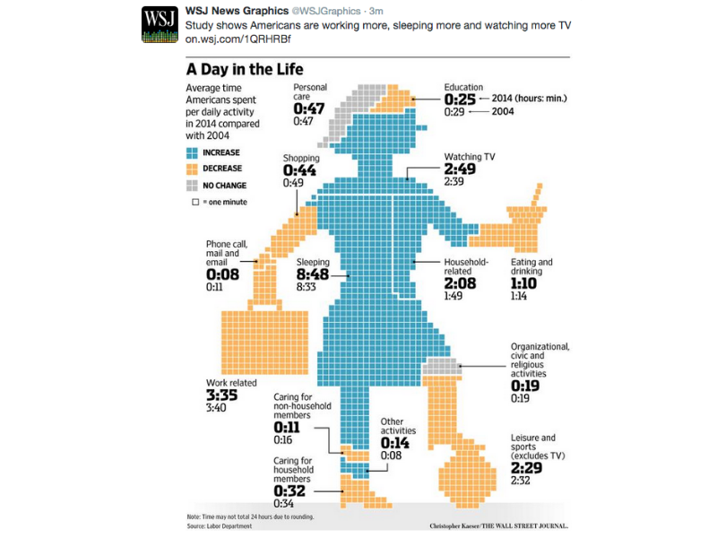

Slide 37


Slide 38
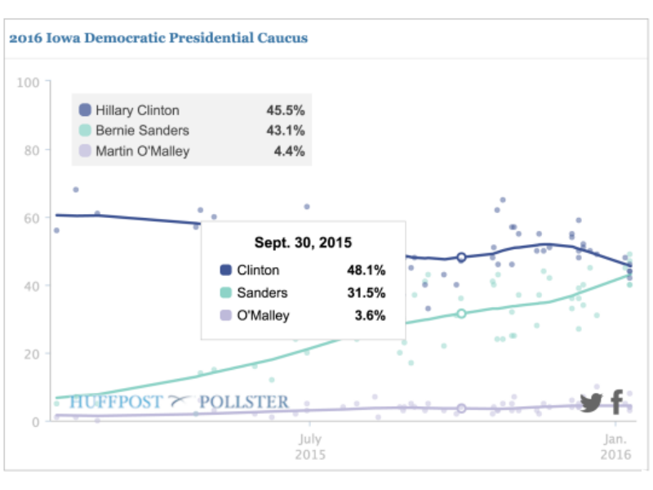

Slide 39
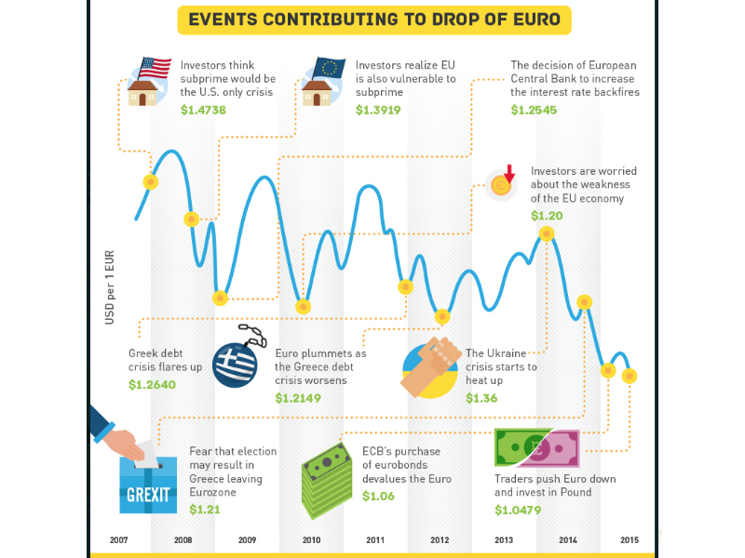

Slide 40


Slide 41


Slide 42
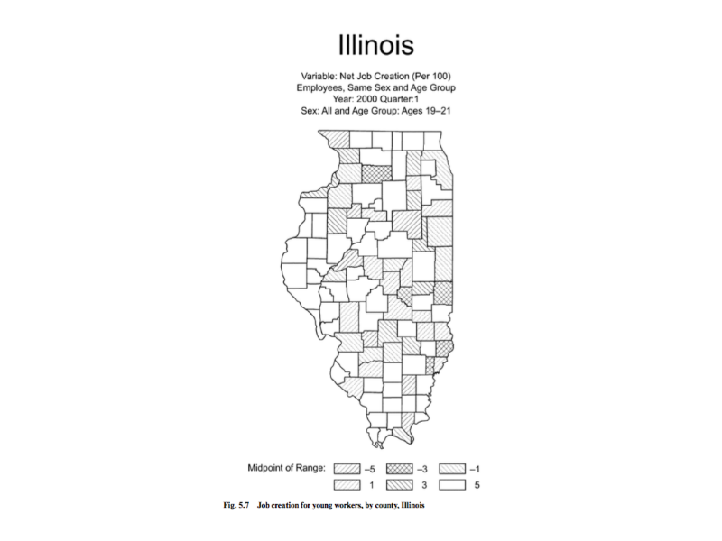

Slide 43
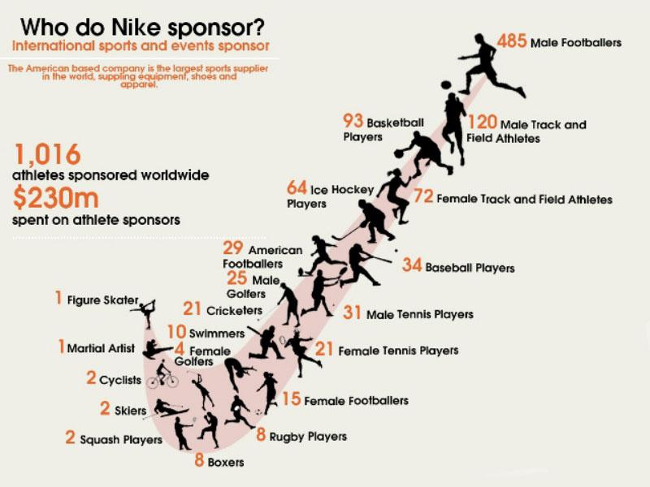

Slide 44
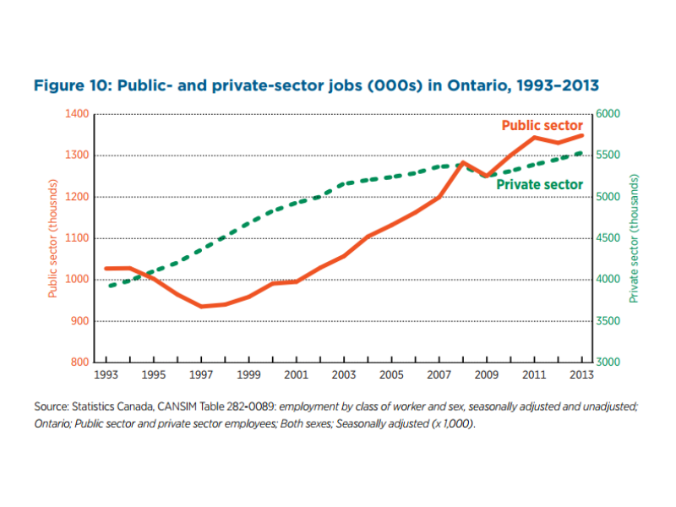

Slide 45
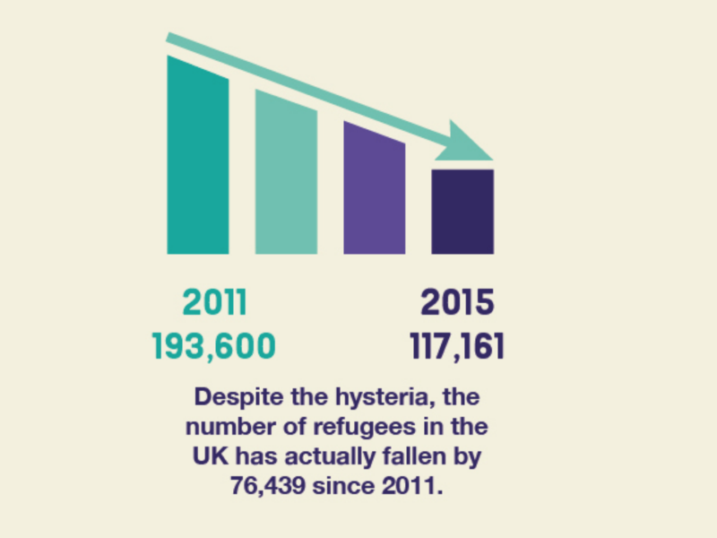

Slide 46
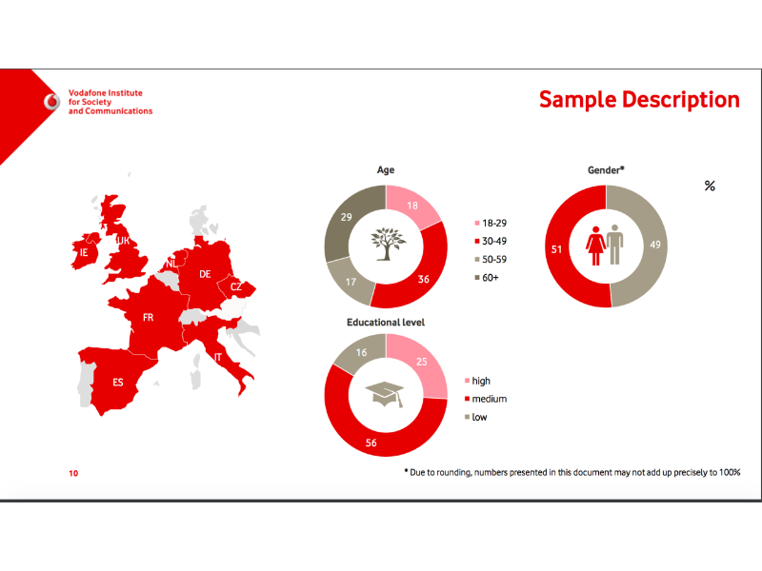

Slide 47
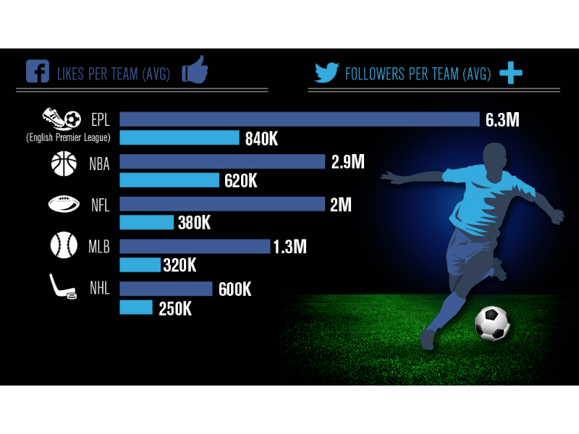

Slide 48
Coming up
No class on Tuesday (happy fall break!)
Thursday: visualizing multiple variables
A2 (scatterplots) due tonight by 11:59pm
Assignment 3: redesign!
Pick a problematic visualization and redesign it
You can use one from today’s lab, or find your own
You may use any medium (Tableau, photoshop, pen & paper, etc.)
Post your redesign / description to Moodle by Oct. 13th at 11:59pm

